Slide 1
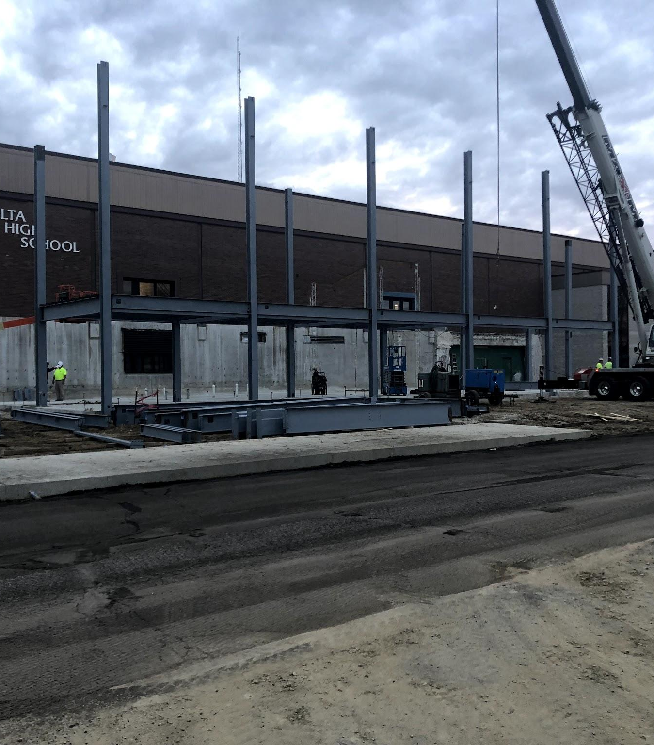
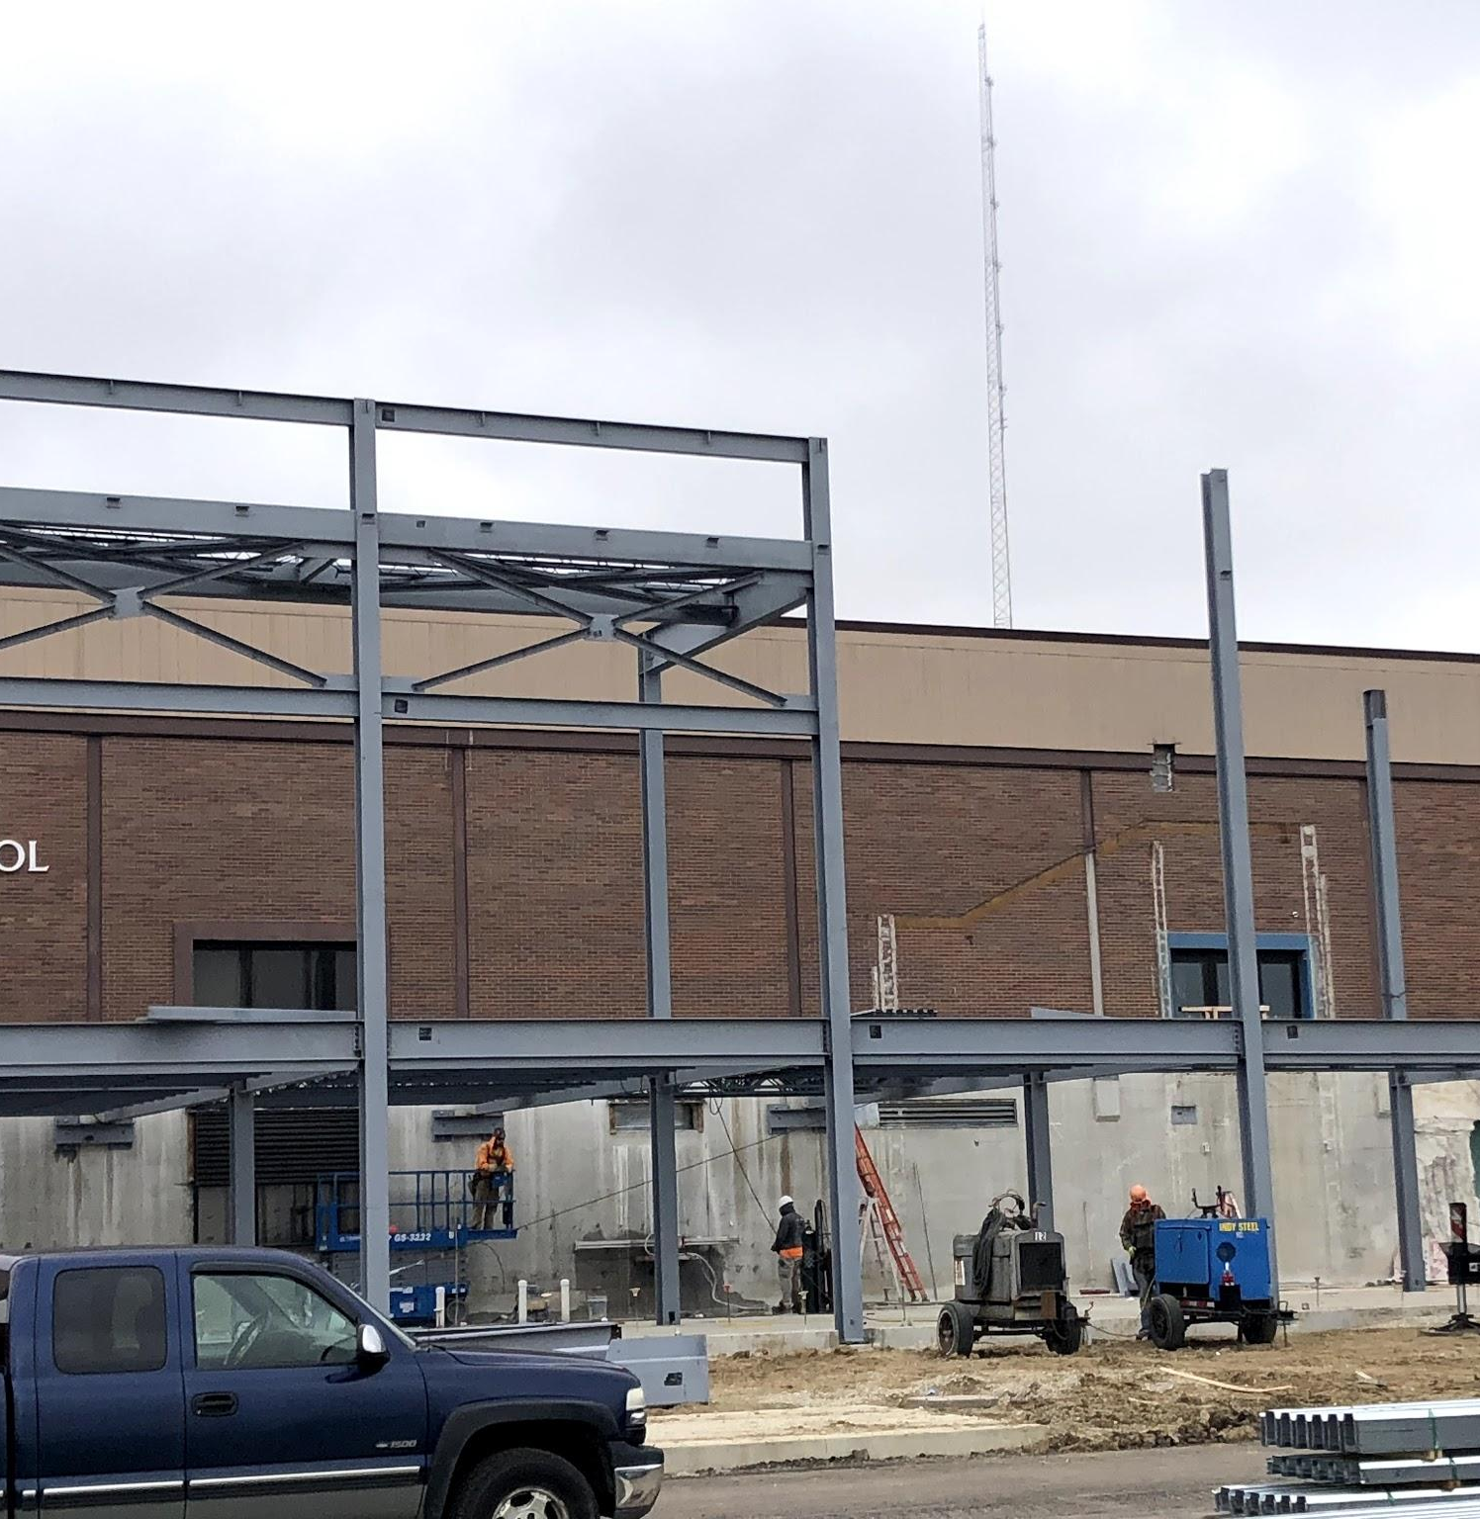
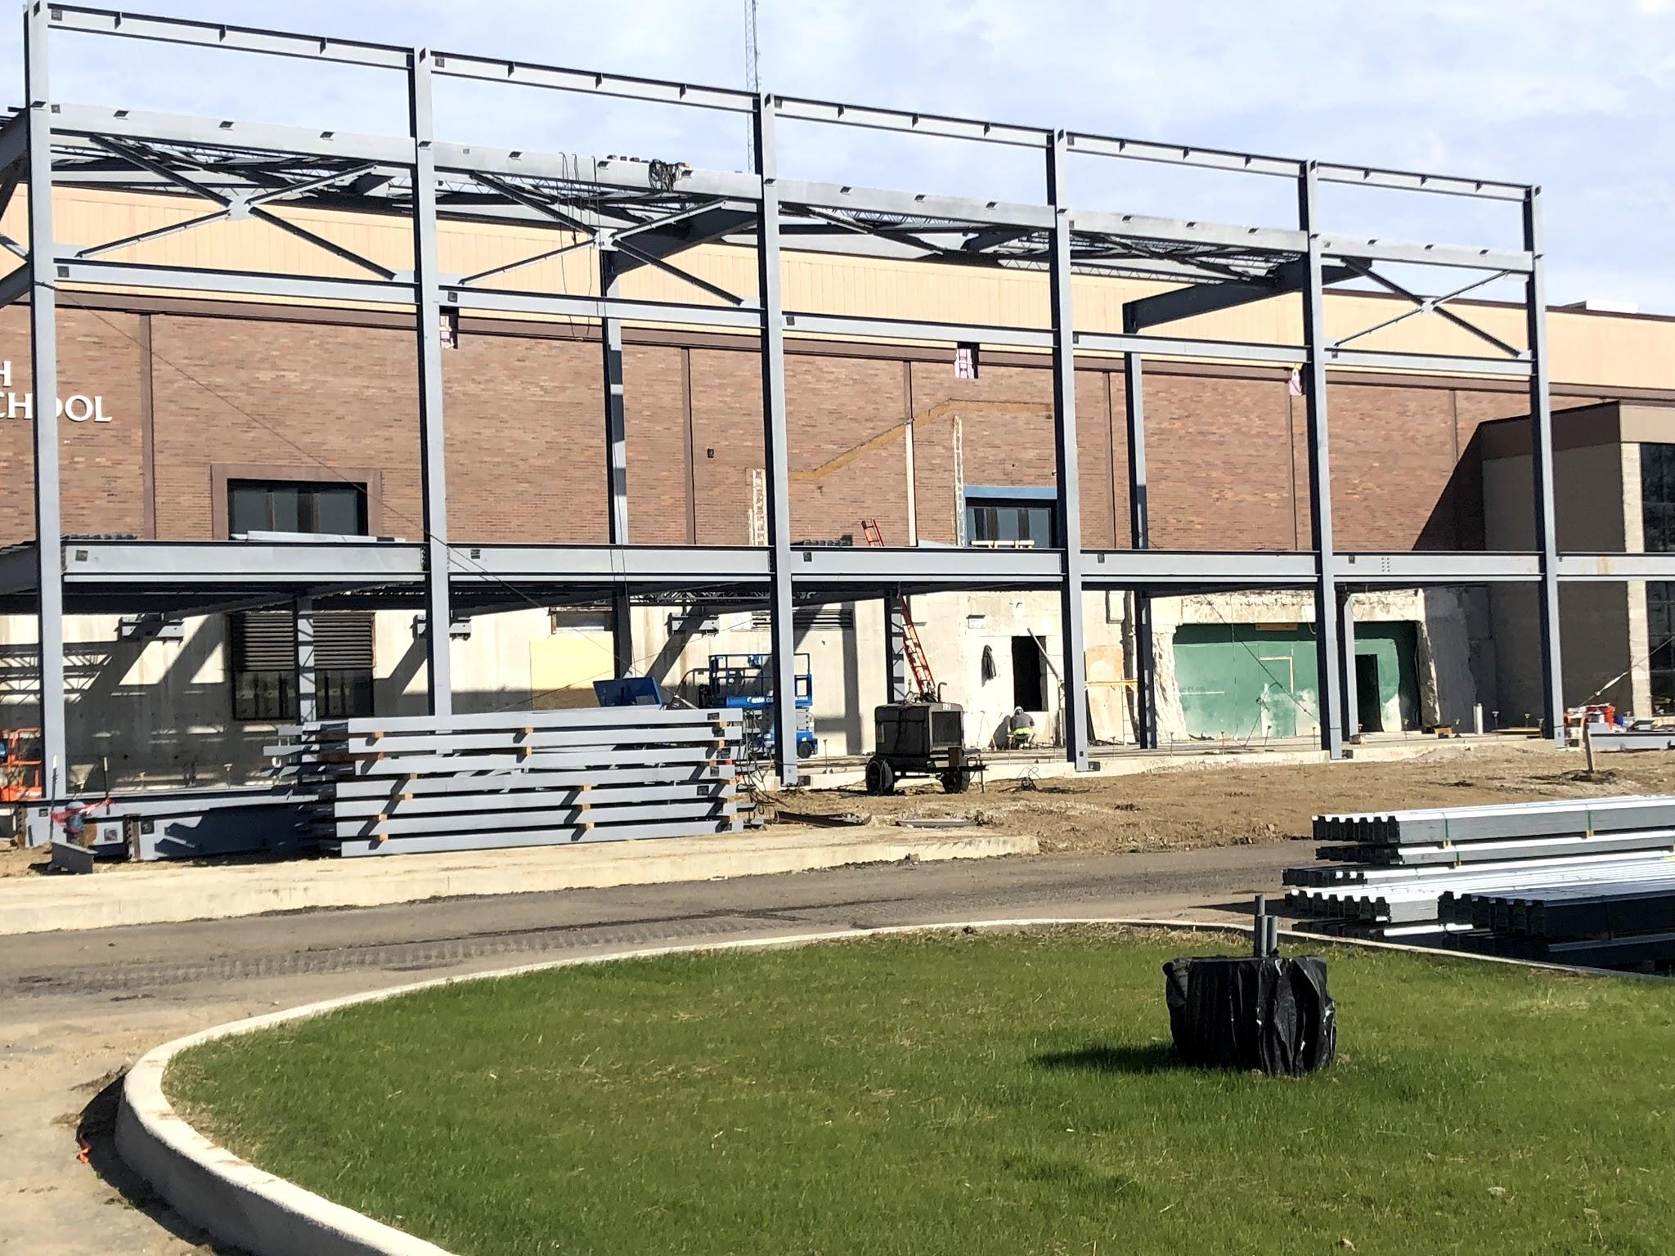
DHS Project 2018
October 22 2018

Slide 2
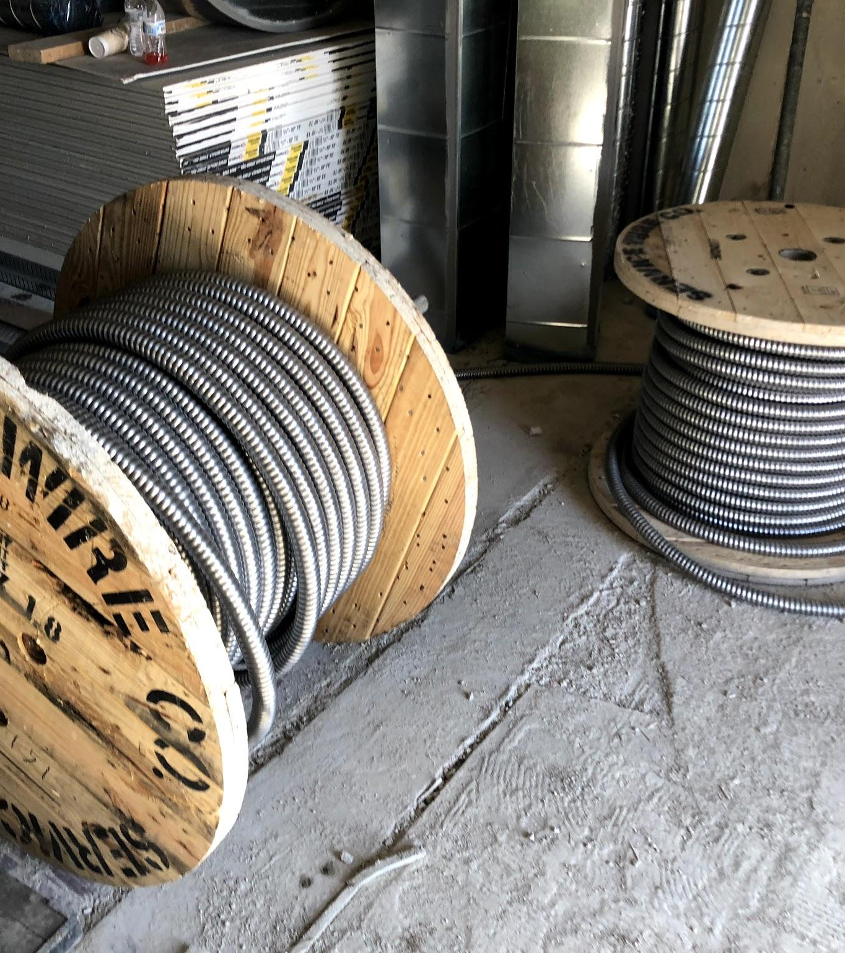
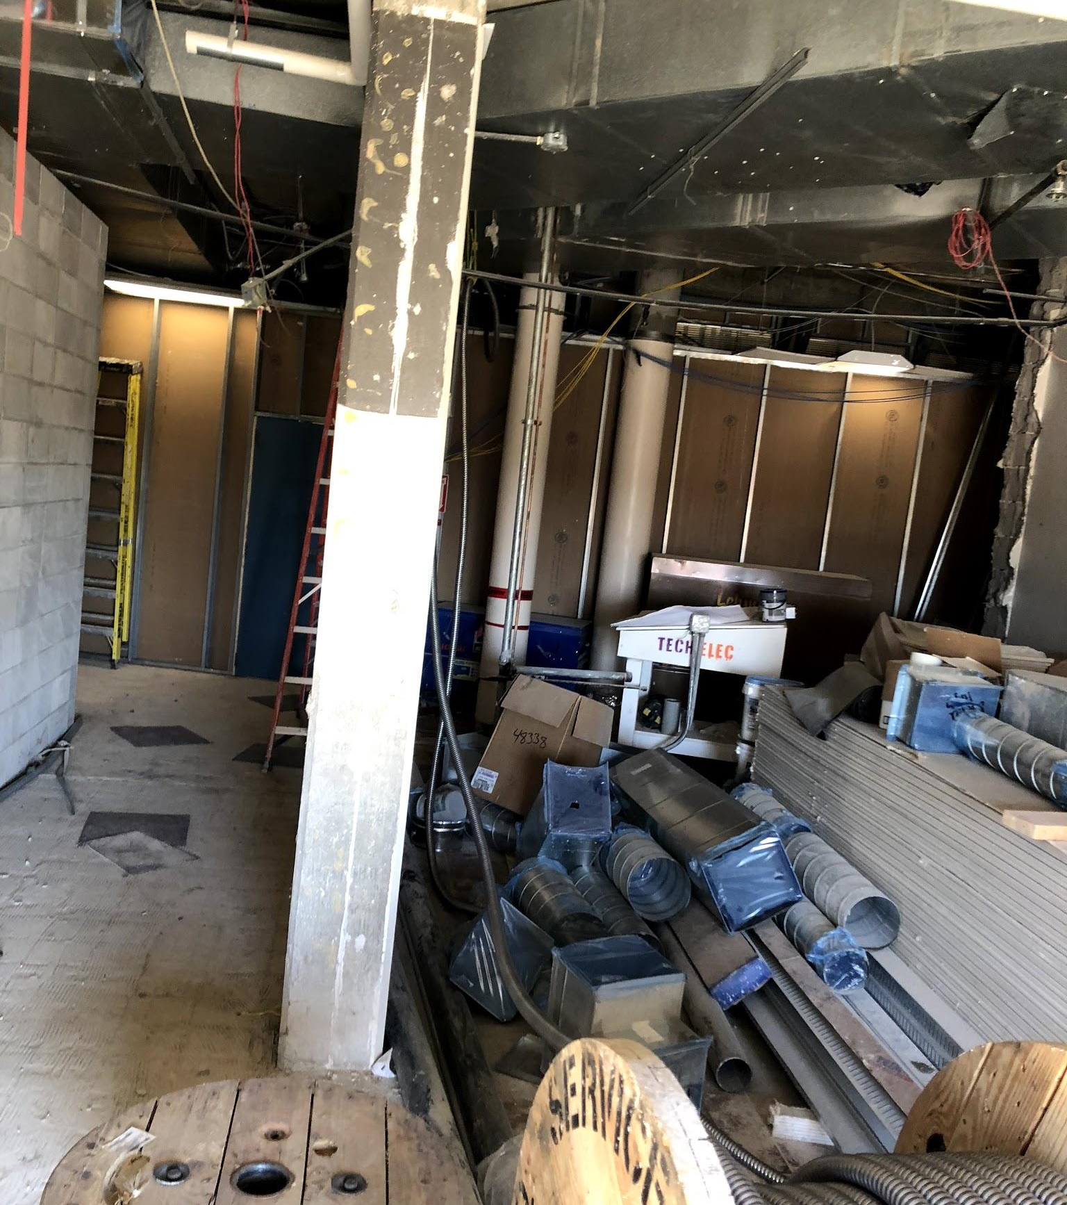
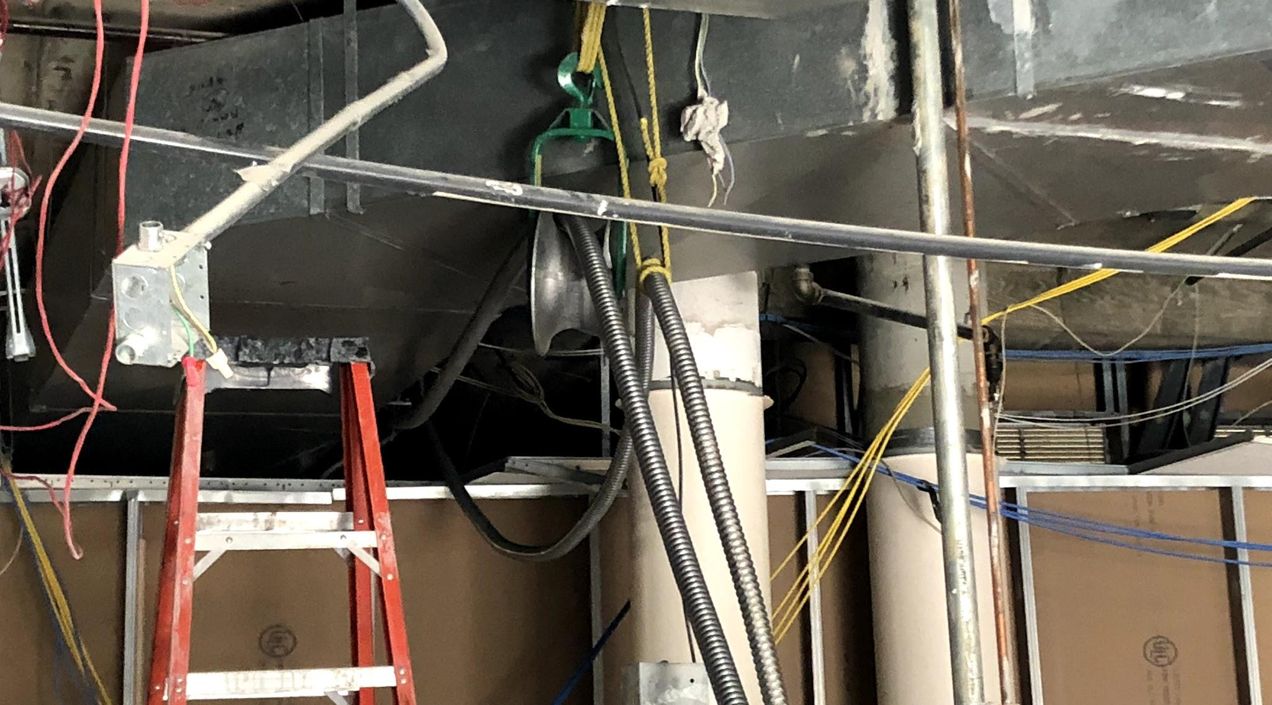
2” conduit was pulled on Friday through a Raceway that was installed after hours all the way through the cafeteria, to the gear room.

Slide 3
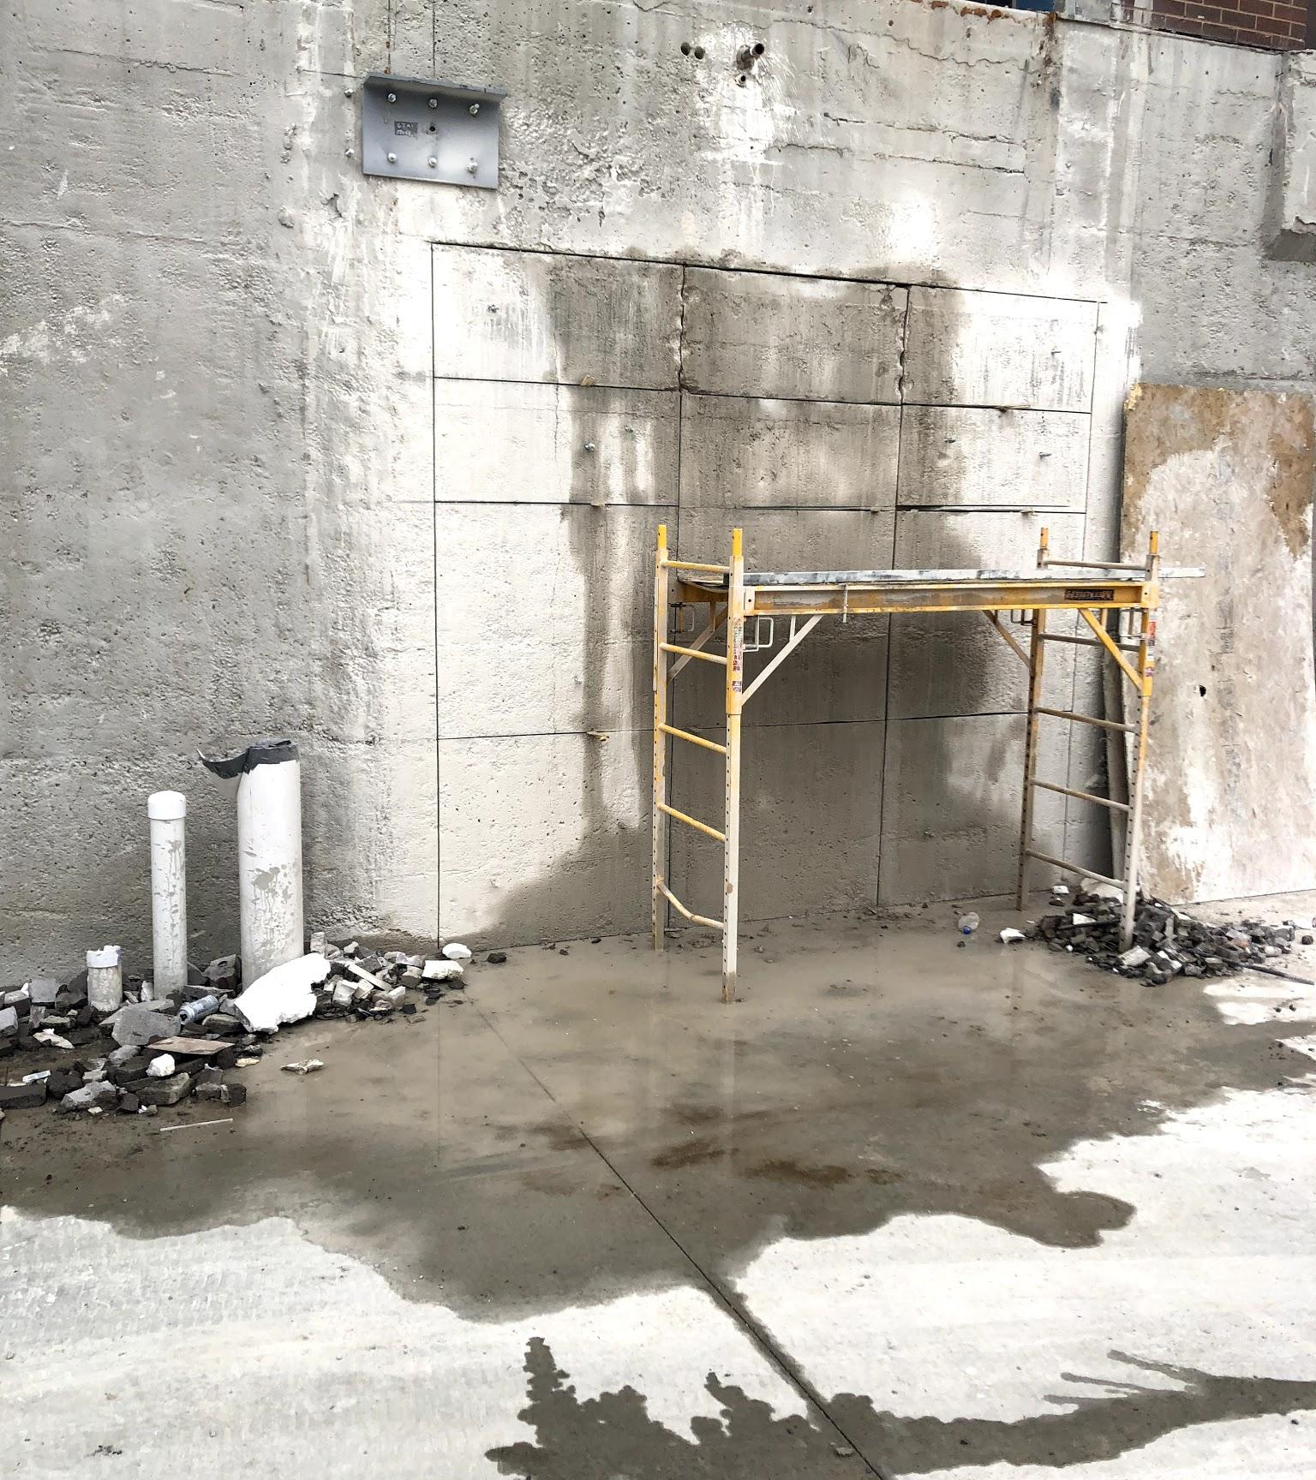
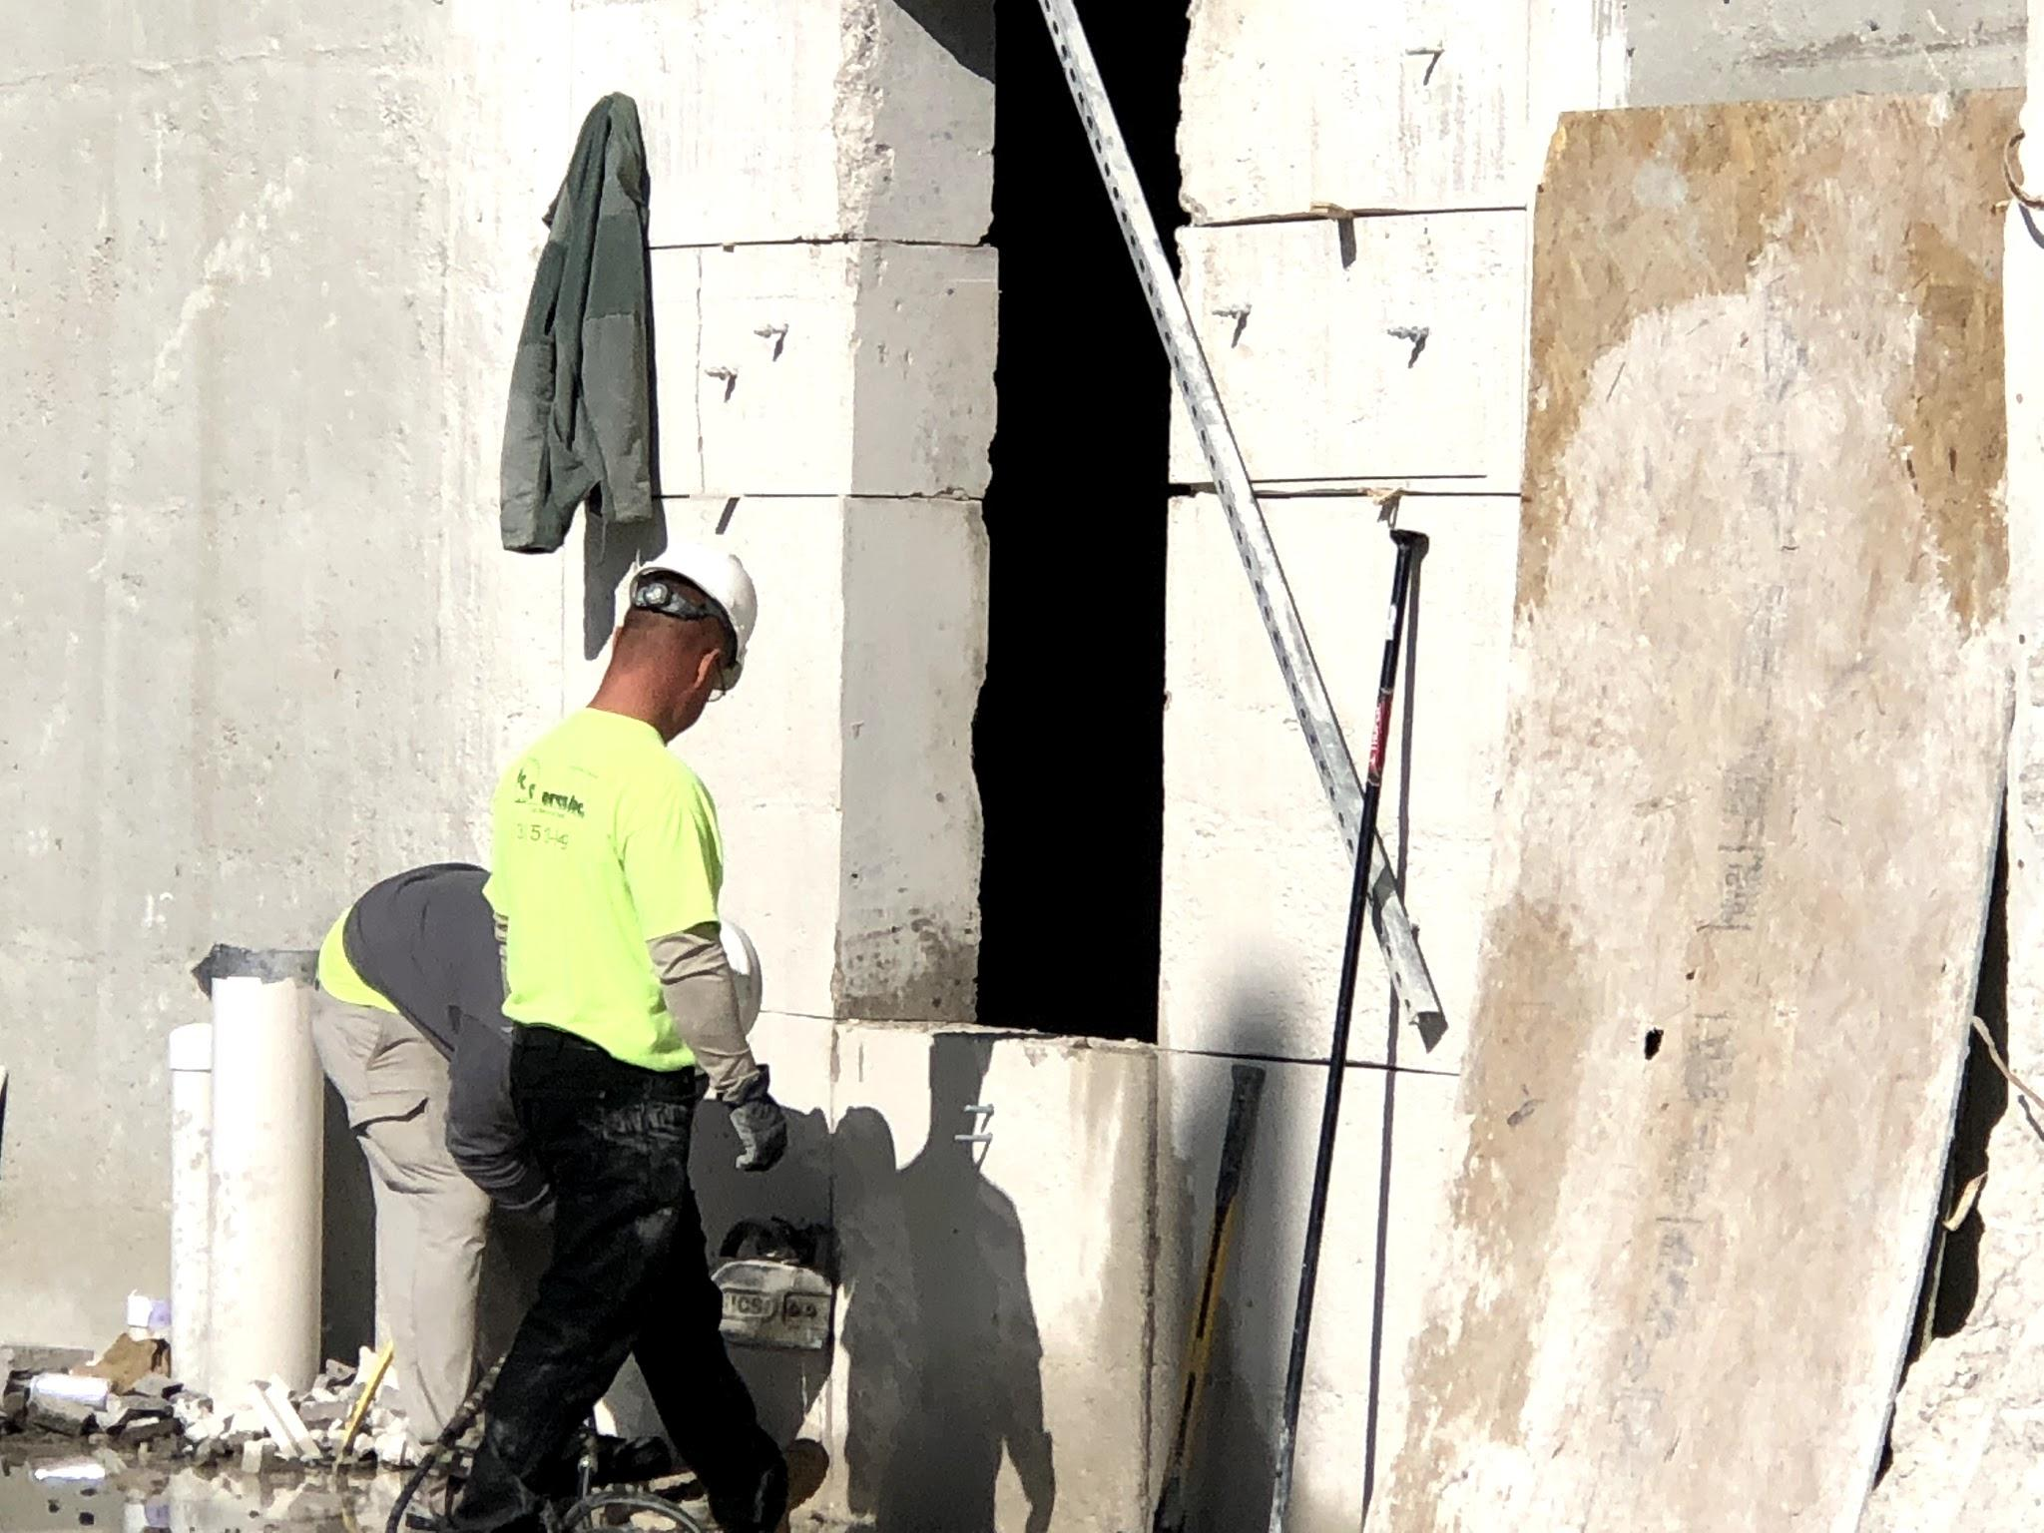
We are patiently awaiting the tough task of opening up our remodeled area to the new construction. This has been a tougher challenge than to be expected due to the size and strength of this mighty building.

Slide 4
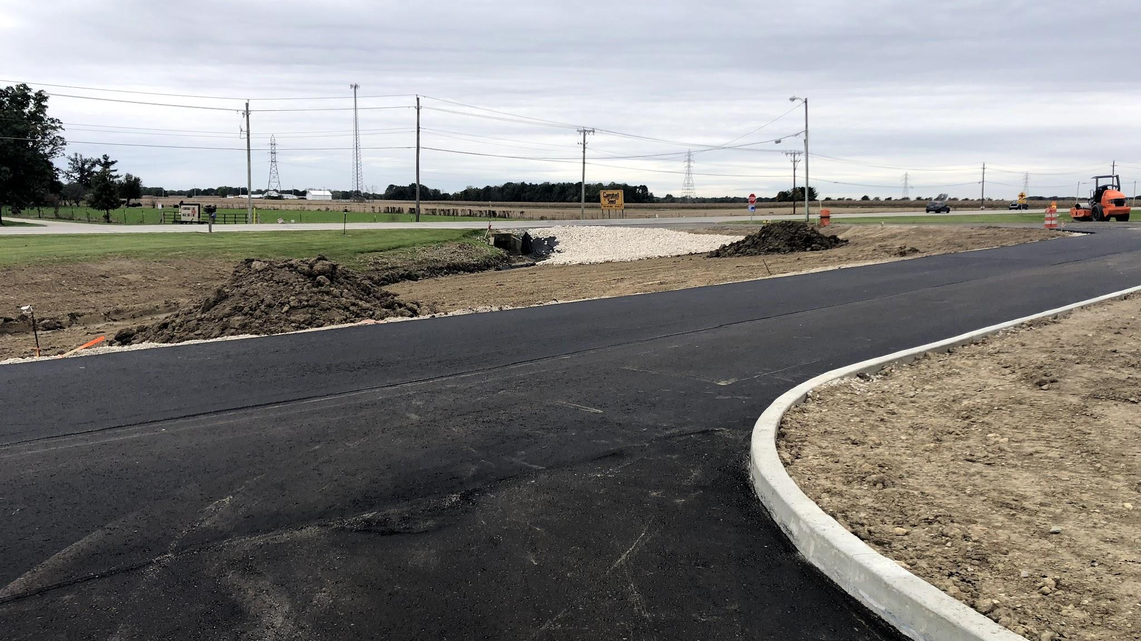

Slide 5
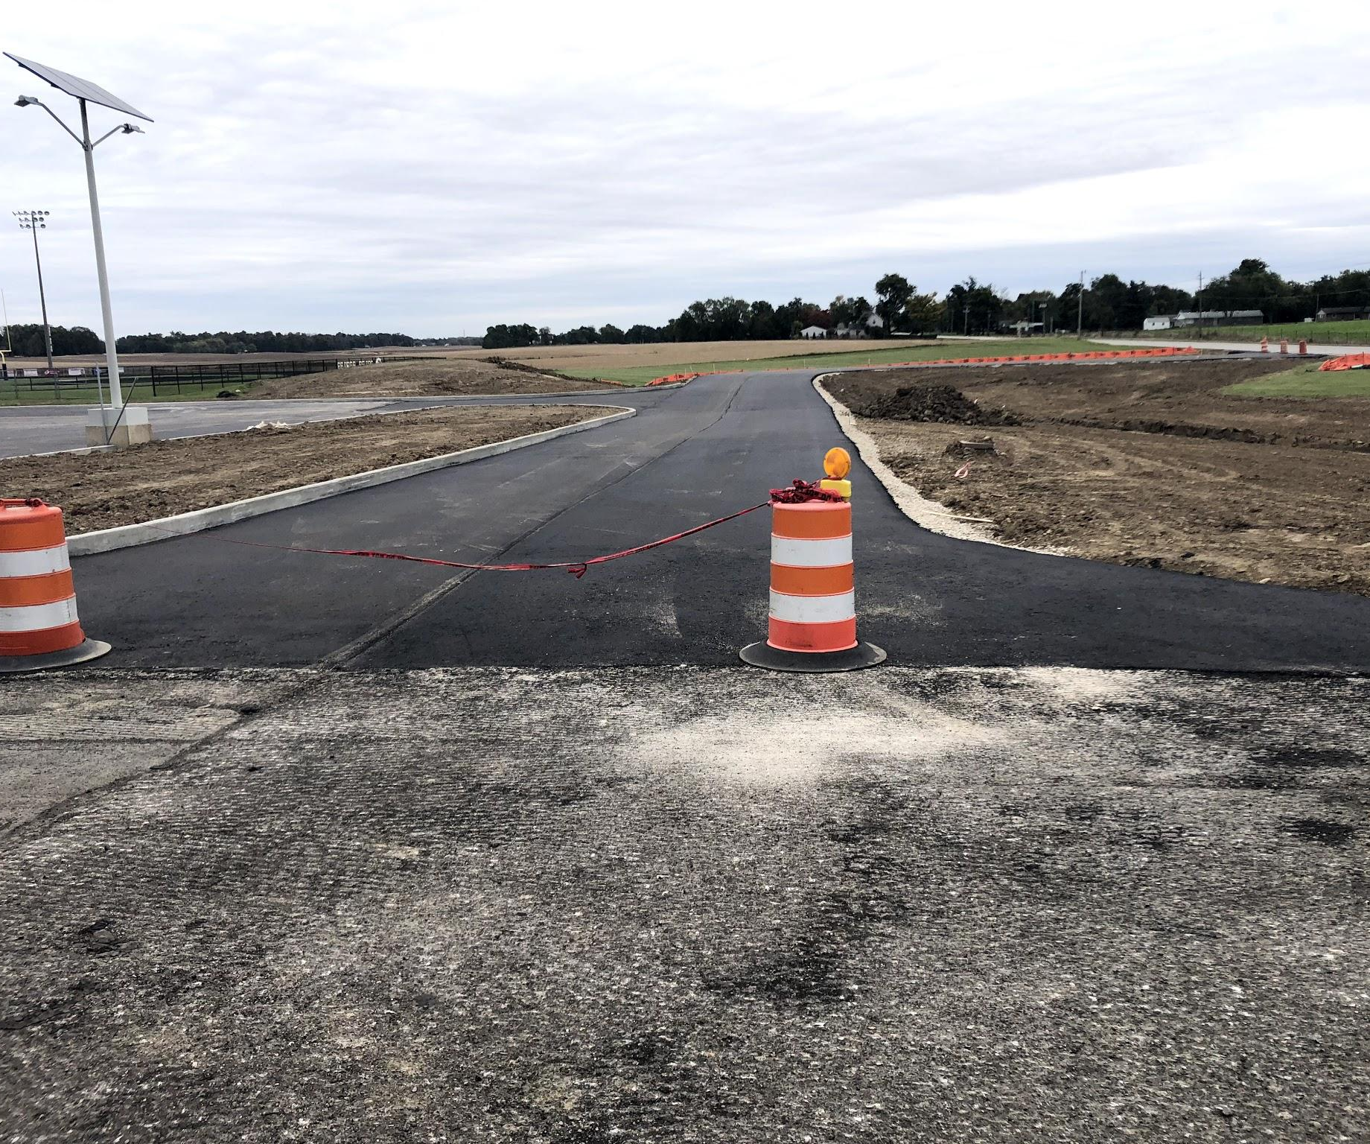
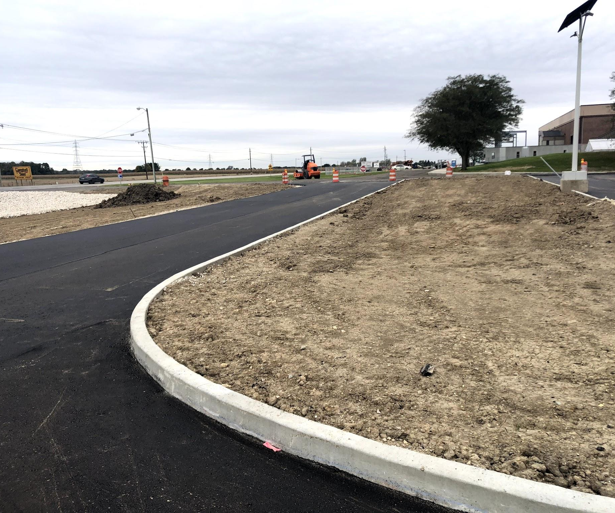
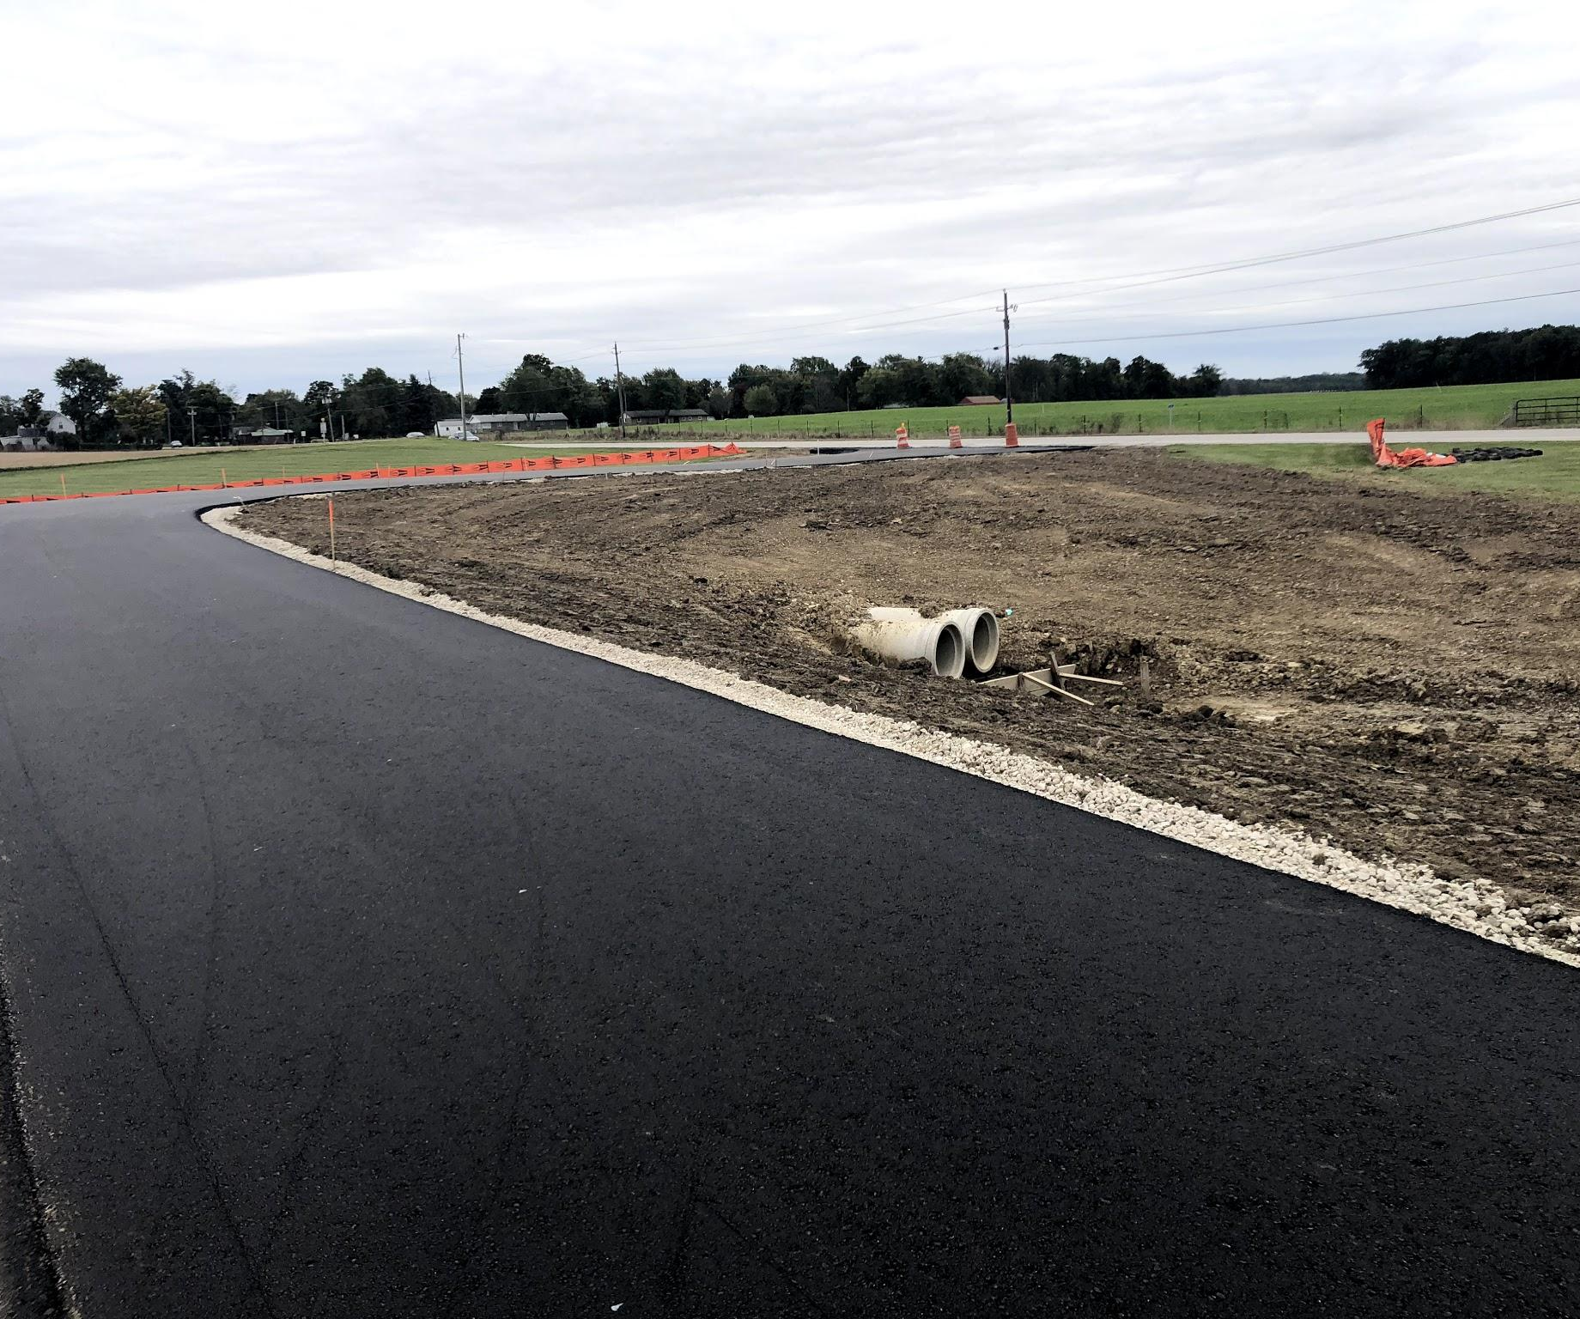

Slide 6
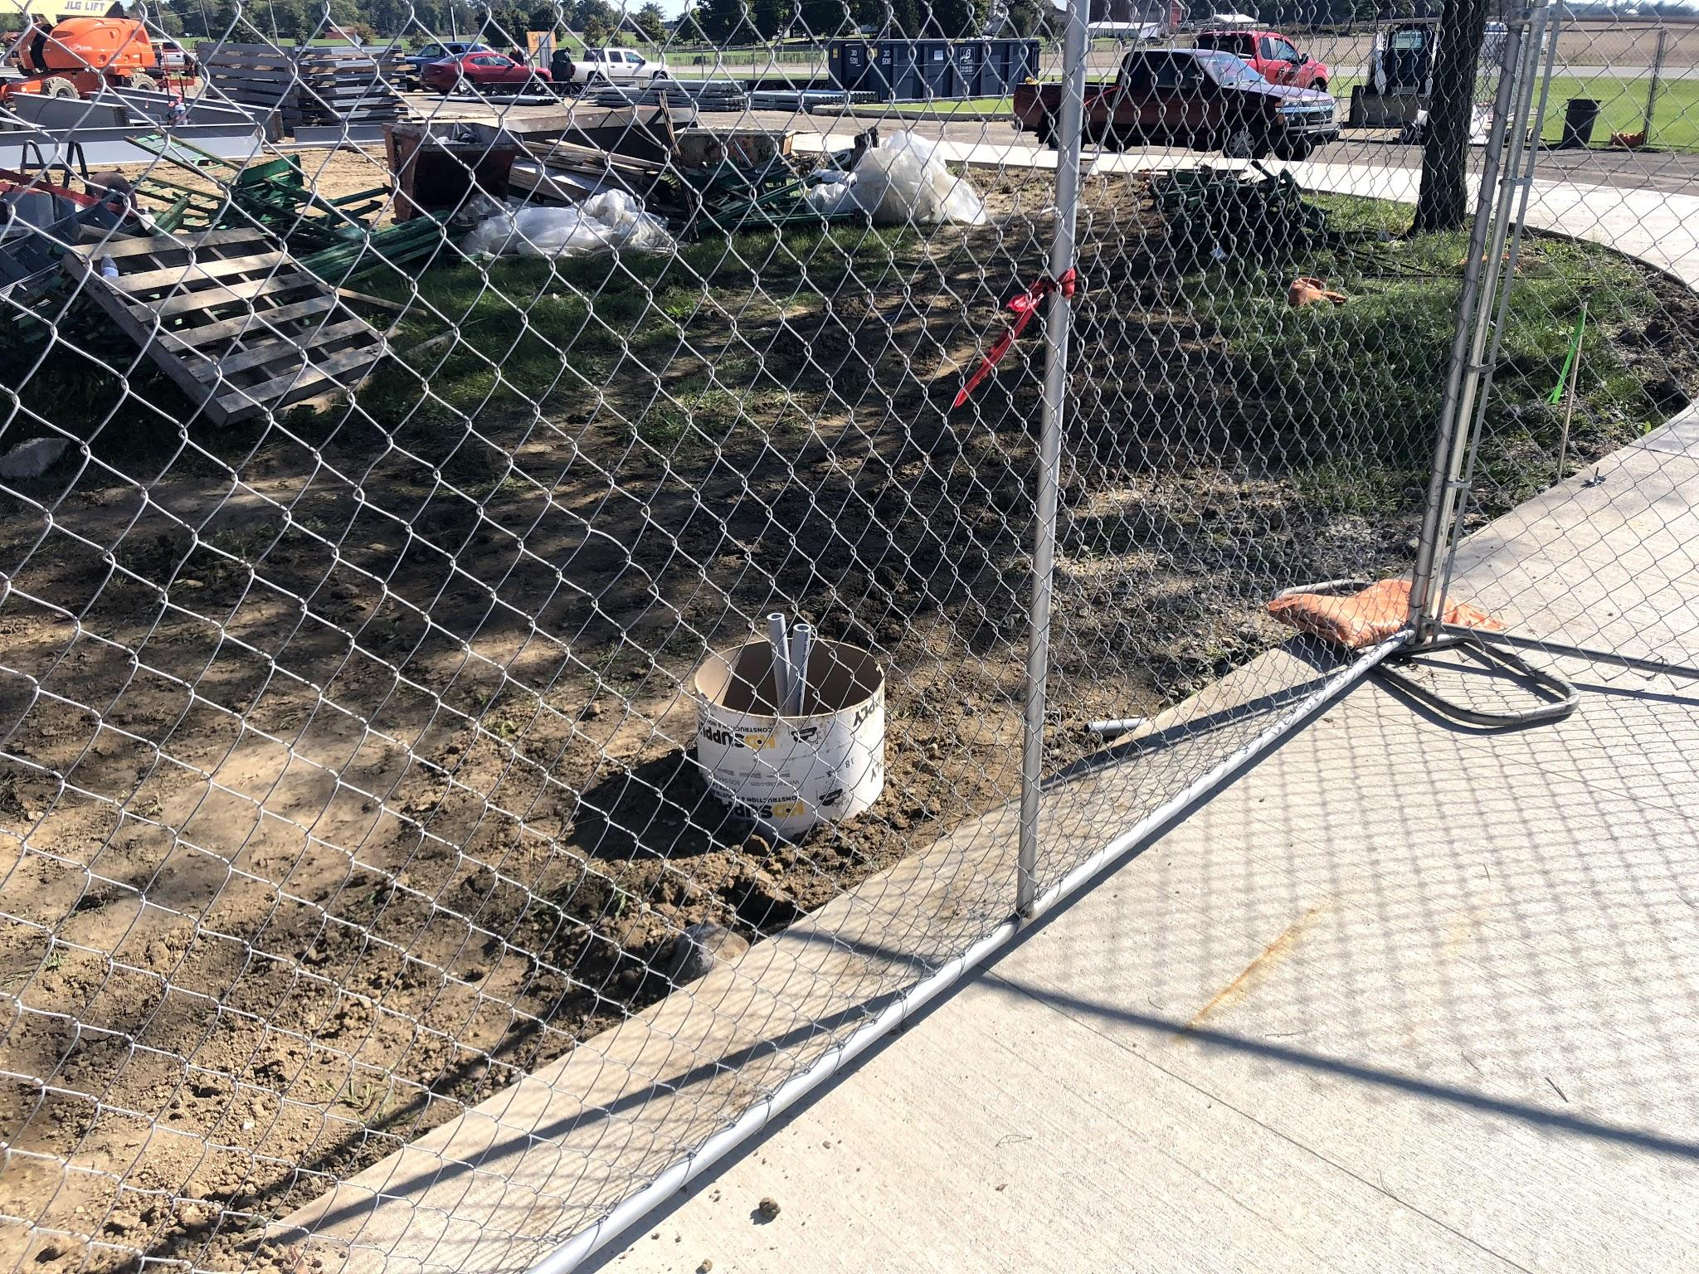
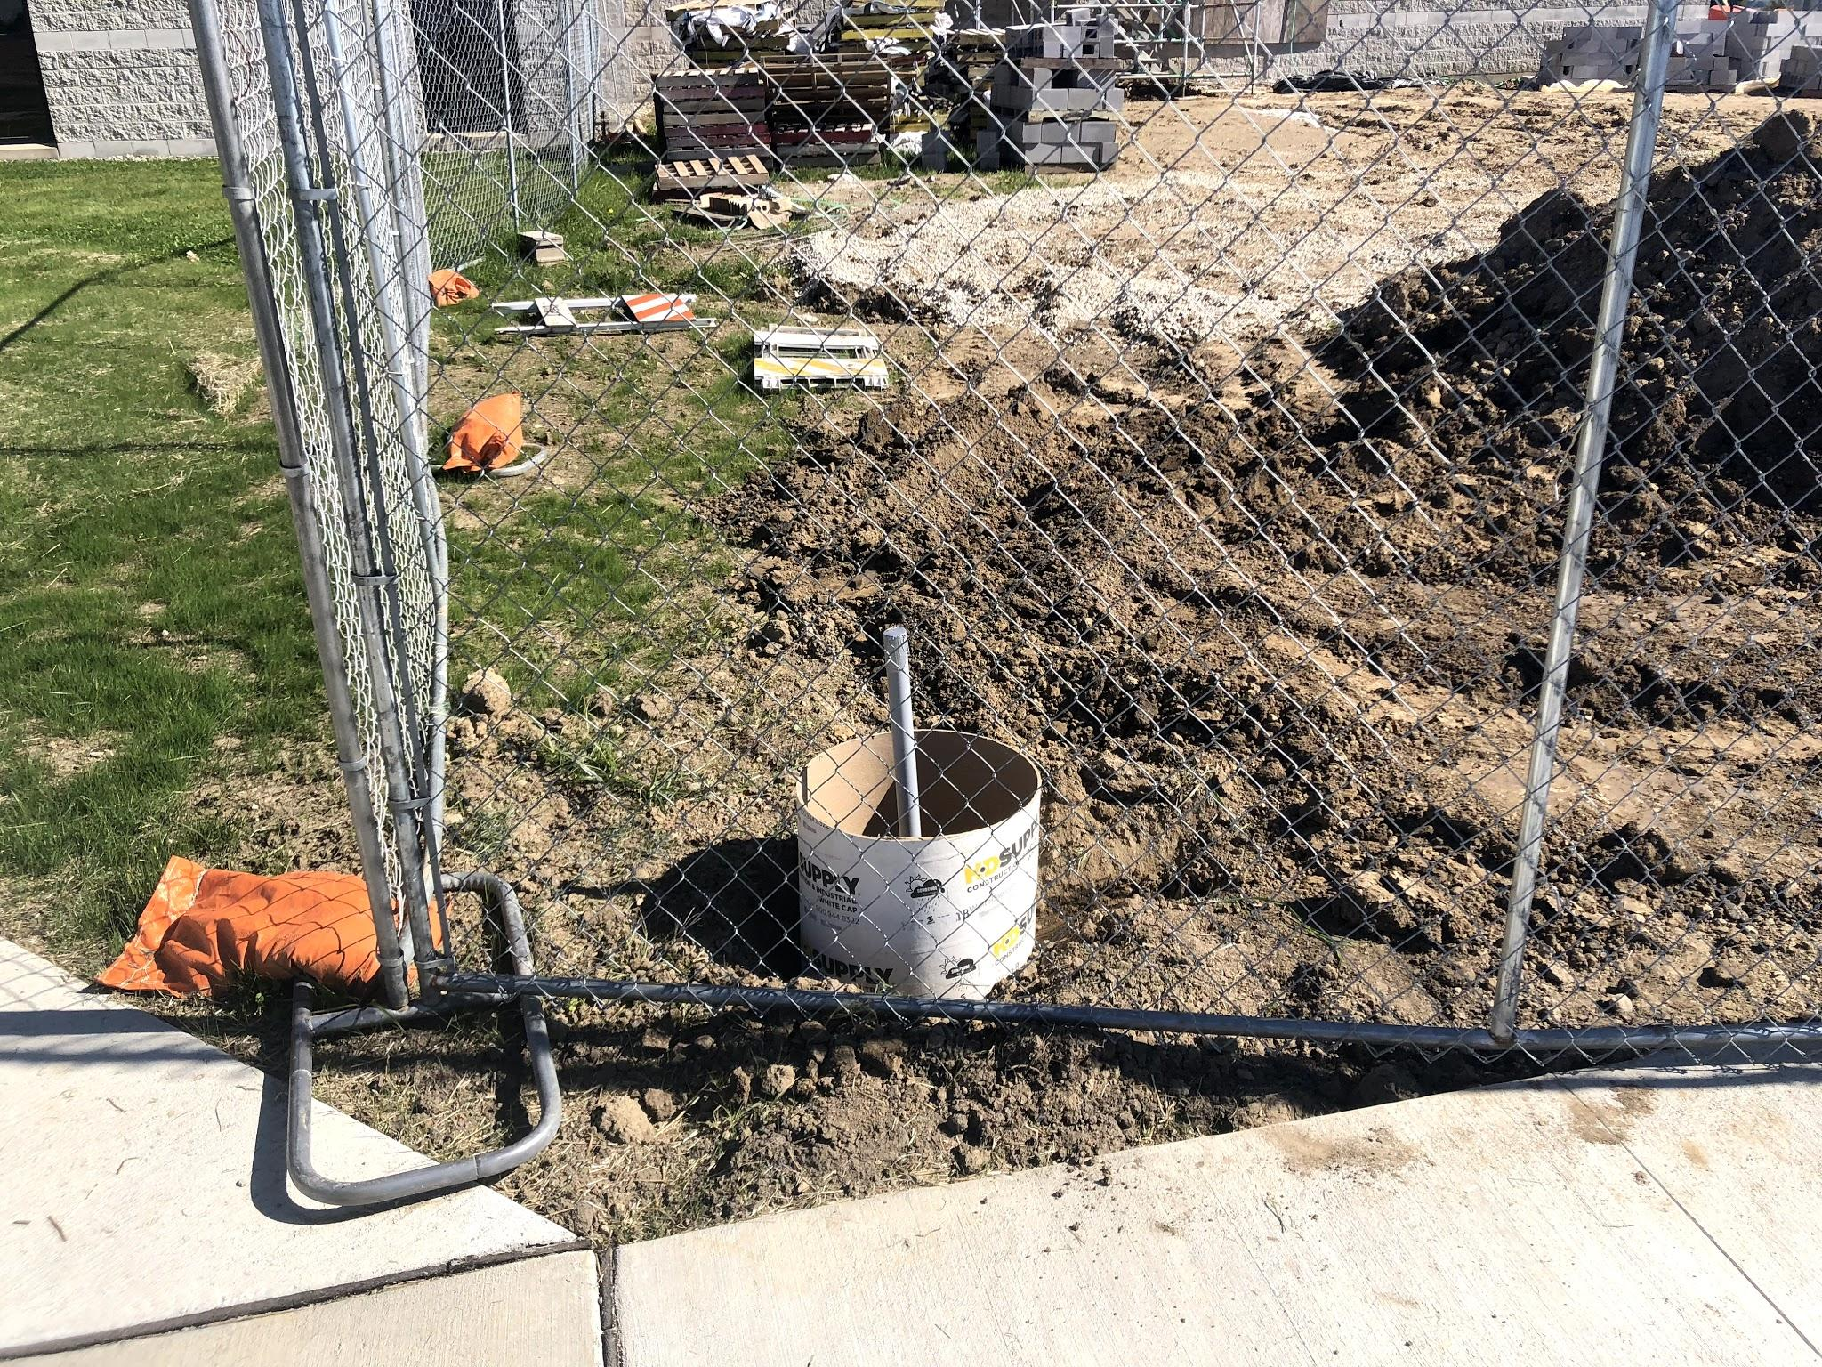
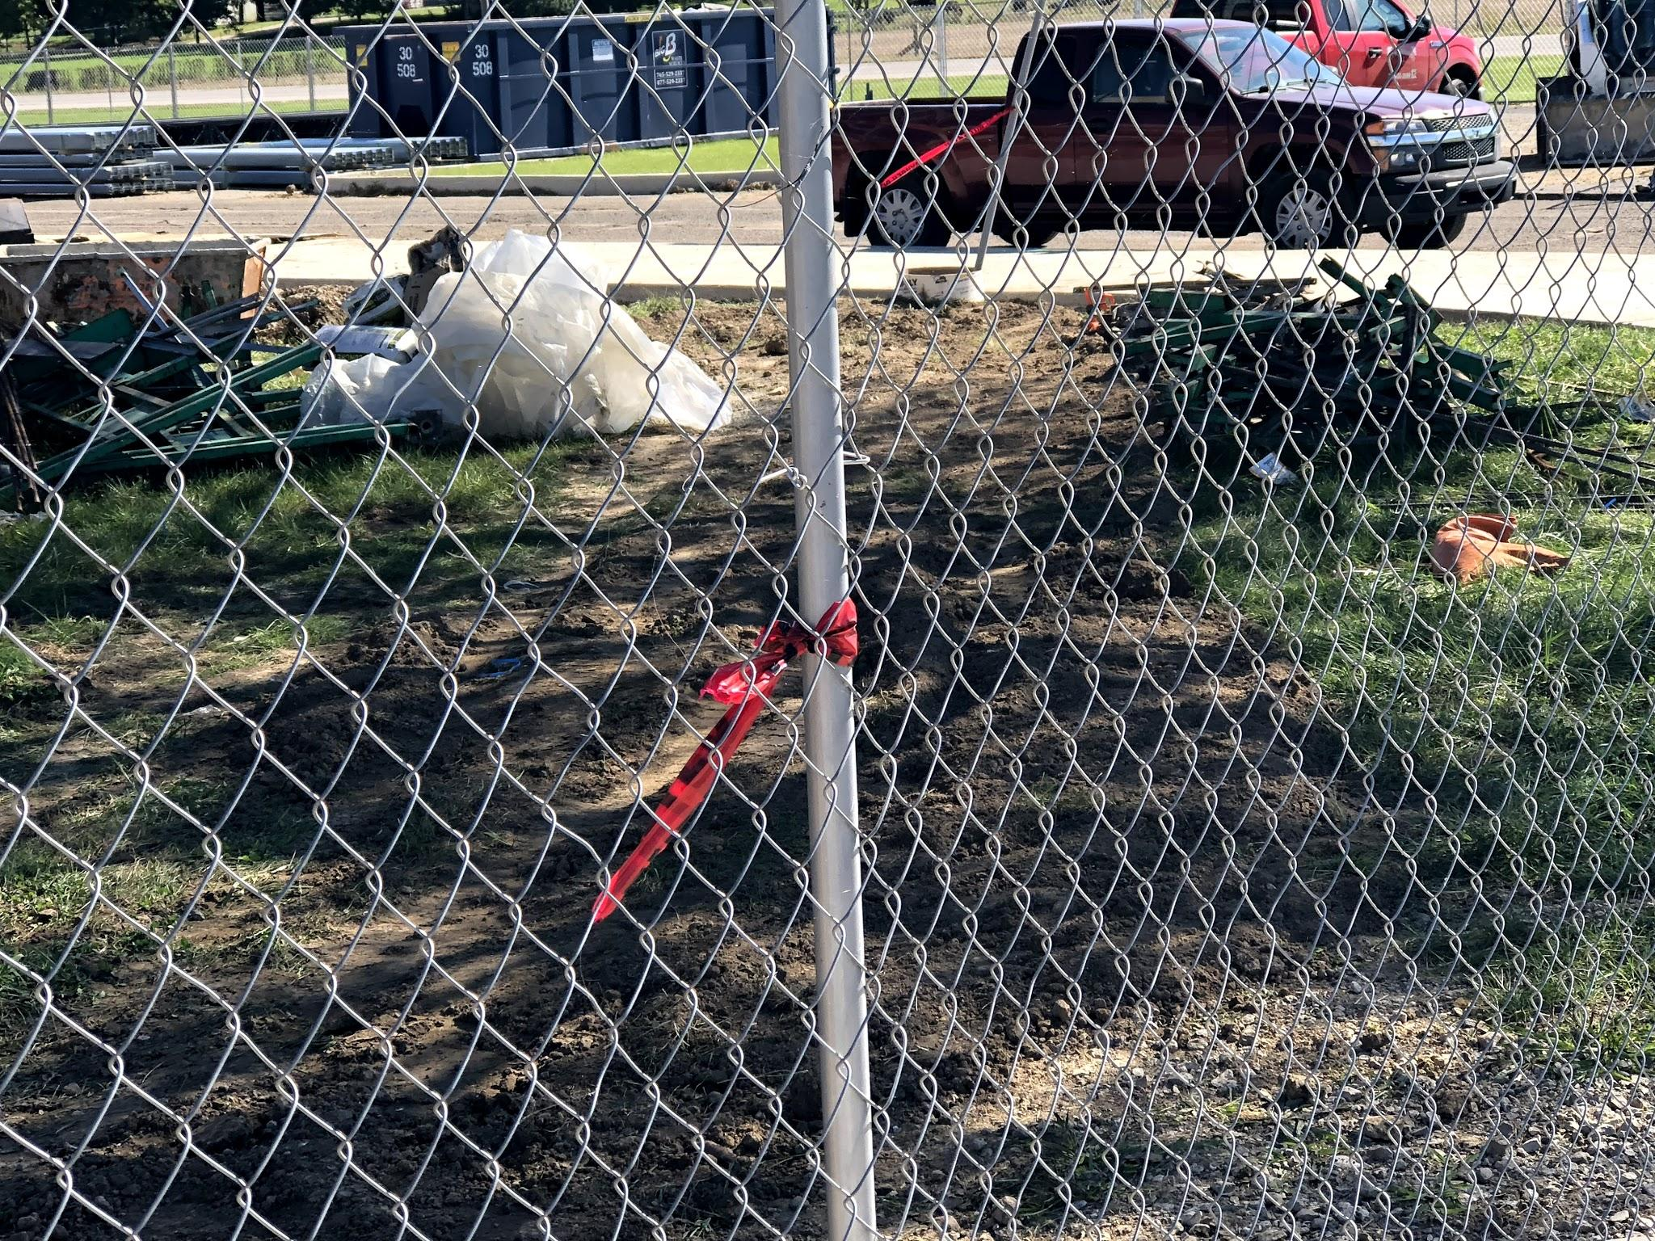
Street lamps are being prepped, Poles are now on sight as well. I would hope that the exterior lighting is a priority, heading into winter.

Slide 7
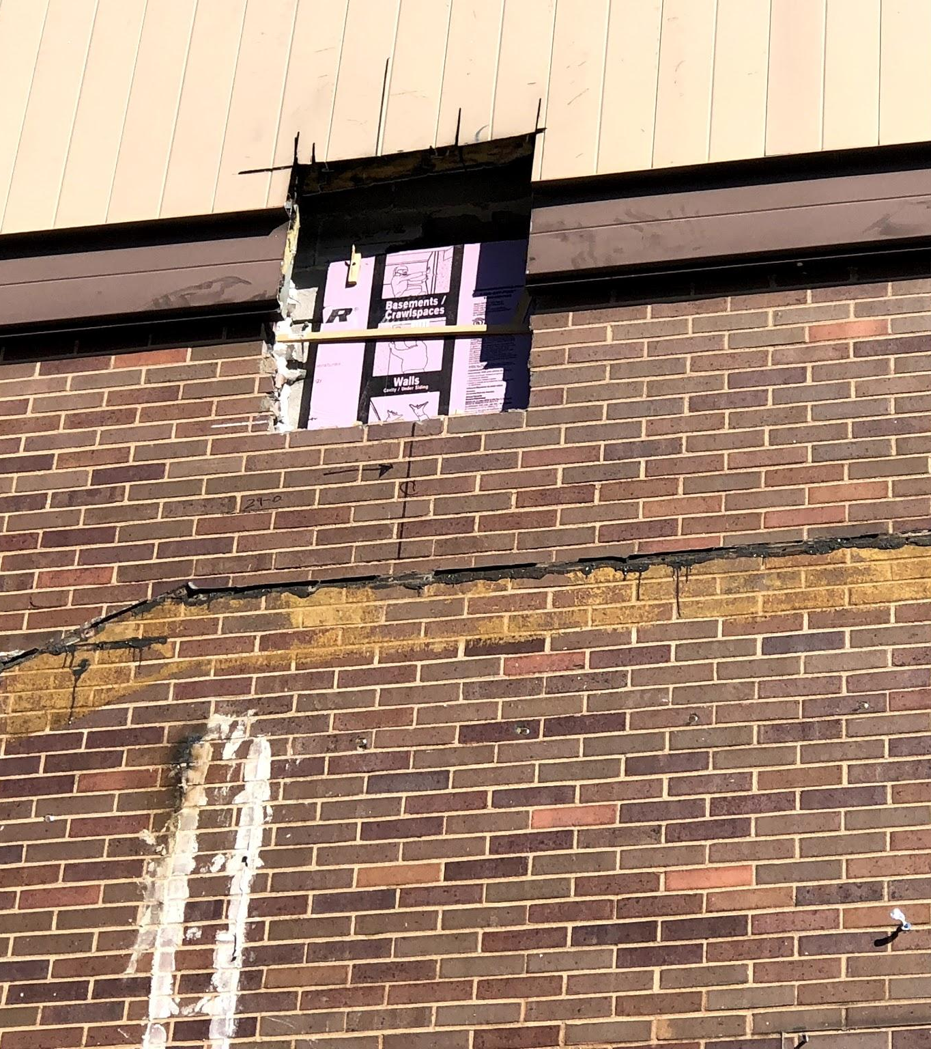
Each connection to the building is slightly different. Holes must be prepped. Connections are often times anchored to the concrete. Some rest upon the CMU walls and are then connected to the existing steel or new welding plates.

Slide 8
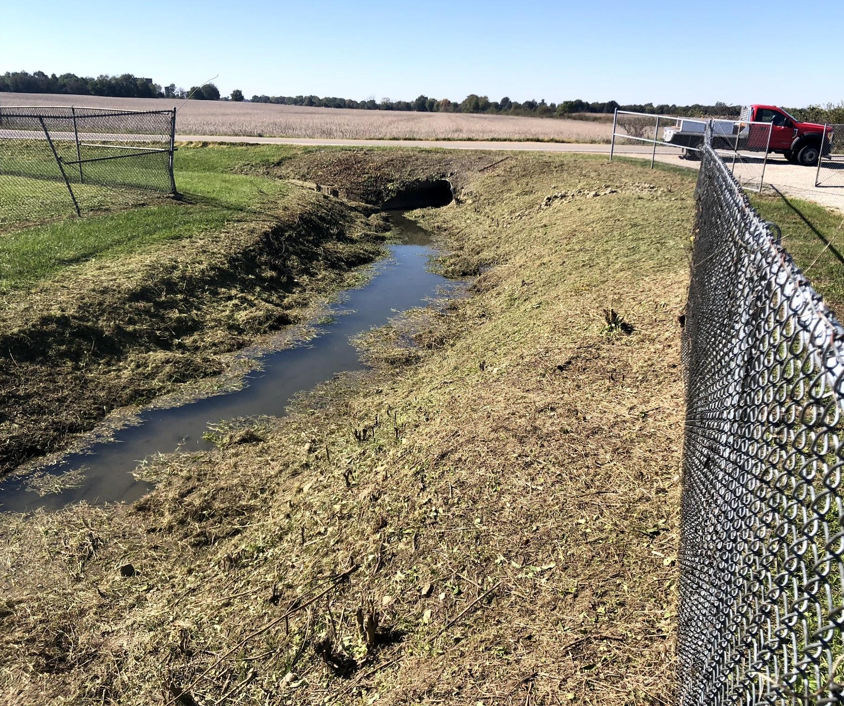
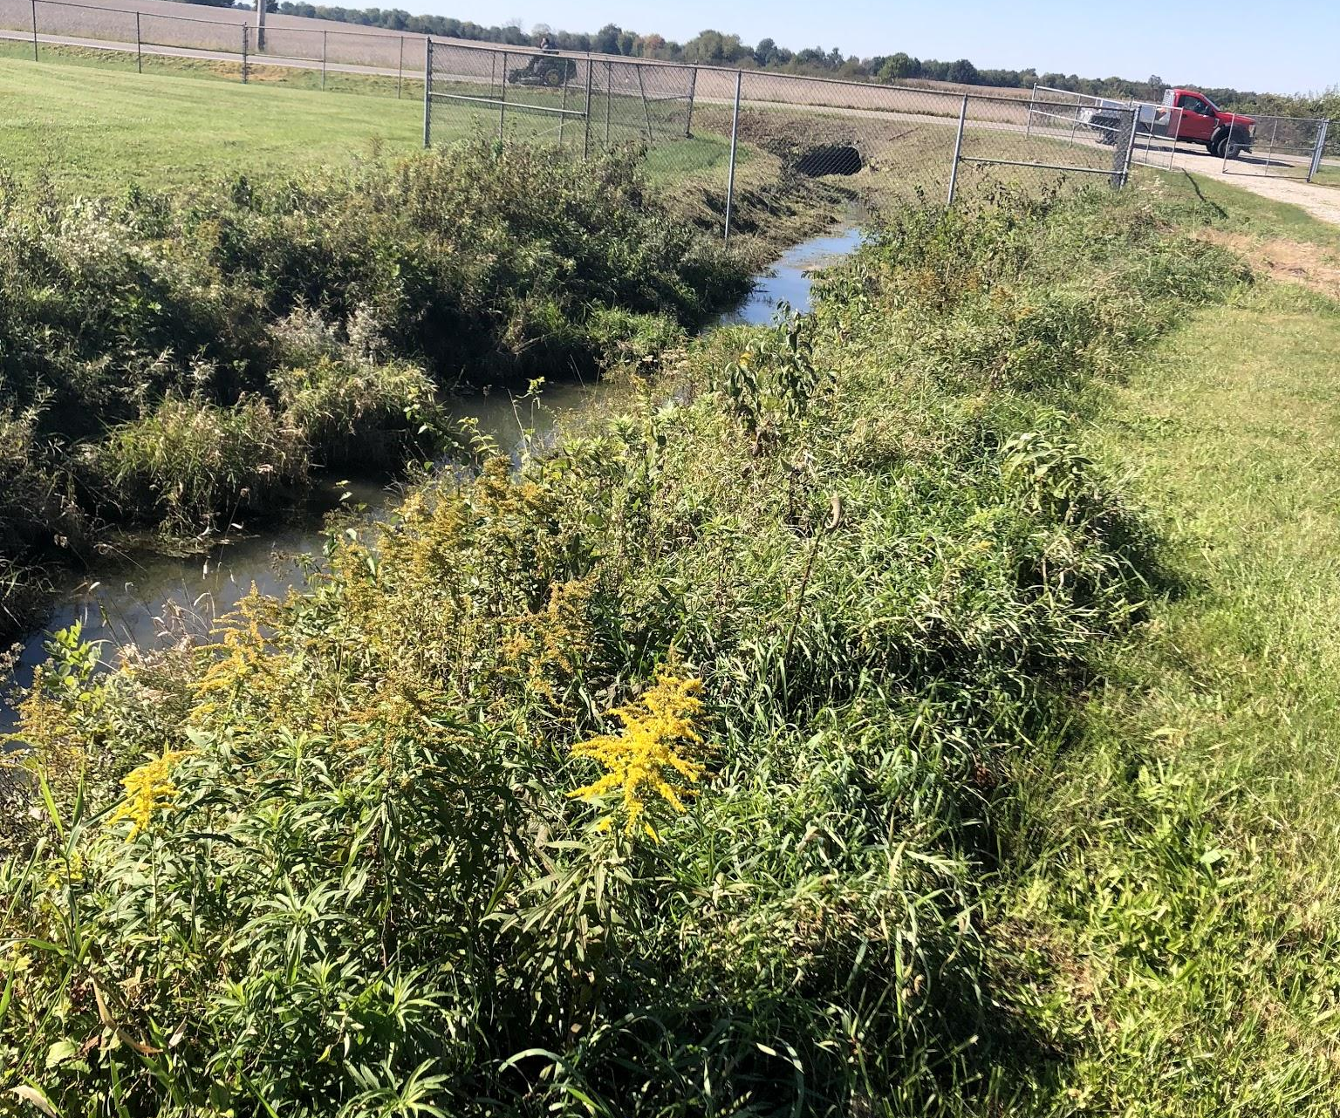
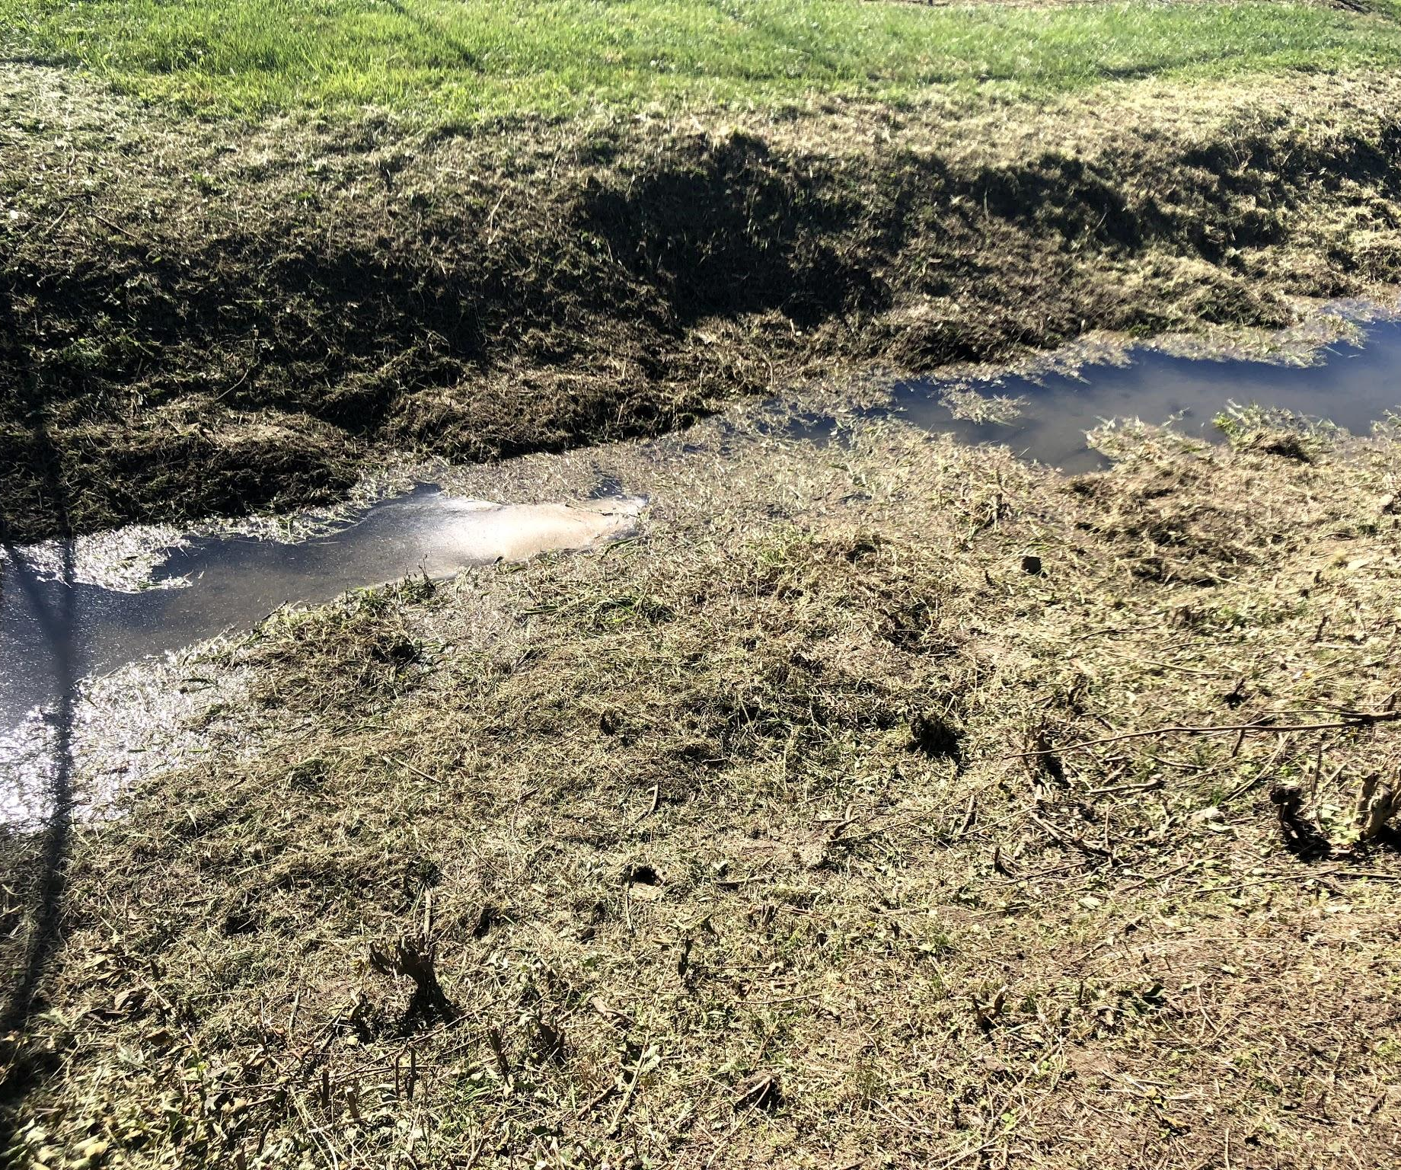
Some of our grounds guys are trying to get the ditch completely cut this fall.

